Slide 1
Text Mining: Techniques, ontologies, and TOOLS
Xiao Liu, Shuo Yu, and Hsinchun Chen
Spring 2019

Slide 2
Introduction
Text mining, also referred to as text data mining, refers to the process of deriving high quality information from text.
Text mining is an interdisciplinary field that draws on information retrieval, data mining, machine learning, statistics and computational linguistics.
Text mining techniques have been applied in a large number of areas, such as business intelligence, health informatics, national security, scientific discovery (especially life science), social media monitoring and etc..

Slide 3
Introduction
In this set of slides, we will cover:
The most commonly used text mining techniques
Ontologies that are often used in text mining
Shared tasks in text mining which reflect the hot topics in the field
Topic modeling & word embedding with selected examples
Open source text mining tools

Slide 4
Text mining techniques
Text Classification
Named Entity Recognition
Sentiment Analysis
Ontology
Topic Modeling
Word Embedding

Slide 5
Text Classification
Text Classification or text categorization is a problem in library science, information science, and computer science. Text classification is the task of choosing correct class label for a given input.
Some examples of text classification tasks are
Deciding whether an email is a spam or not (spam detection) .
Deciding whether the topic of a news article is from a fixed list of topic areas such as “sports”, “technology”, and “politics” (document classification).
Deciding whether a given occurrence of the word bank is used to refer to a river bank, a financial institution, the act of tilting to the side, or the act of depositing something in a financial institution (word sense disambiguation).

Slide 6
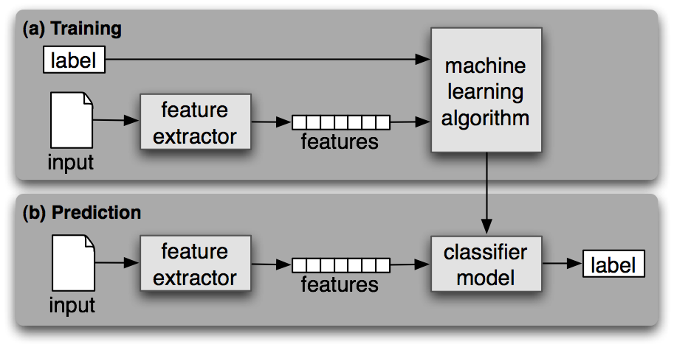
Text Classification
Text classification is a supervised machine learning task as it is built based on training corpora containing the correct label for each input. The framework for classification is shown in figure below.
(a) During training, a feature extractor is used to convert each input value to a feature set. These feature sets, which capture the basic information about each input that should be used to classify it, are discussed in the next section. Pairs of feature sets and labels are fed into the machine learning algorithm to generate a model.
(b) During prediction, the same feature extractor is used to convert unseen inputs to feature sets. These feature sets are then fed into the model, which generates predicted labels.

Slide 7
Support Vector Machine: Classification
Topic Categorization
Motivation: Digital Libraries!!!
Dumais et al. (1998) at Microsoft Research conducted an in depth topic categorization study comparing linear SVM with other techniques on the Reuters corpus: best among most DM techniques.
 | Findsim | NBayes | BayesNets | Trees | LinearSVM
Earn | 92.9% | 95.9% | 95.8% | 97.8% | 98.0%
Acq | 64.7% | 87.8% | 88.3% | 89.7% | 93.6%
Money-fx | 46.7% | 56.6% | 58.8% | 66.2% | 74.5%
Grain | 67.5% | 78.8% | 81.4% | 85.0% | 94.6%
Crude | 70.1% | 79.5% | 79.6% | 85.0% | 88.9%
Trade | 65.1% | 63.9% | 69.0% | 72.5% | 75.9%
Interest | 63.4% | 64.9% | 71.3% | 67.1% | 77.7%
Ship | 49.2% | 85.4% | 84.4% | 74.2% | 85.6%
Wheat | 68.9% | 69.7% | 82.7% | 92.5% | 91.8%
Corn | 48.2% | 65.3% | 76.4% | 91.8% | 90.3%
Avg. Top 10 | 64.4% | 81.5% | 85.0% | 88.4% | 92.0%
Avg. All Cat | 61.7% | 75.2% | 80.0% | N/A | 87.0%

Slide 8
Text Classification
Common features for text classification include: bag-of words (BOW), bigrams, tri-grams and part-of-speech (POS) tags for each word in the document.
The most commonly adopted machine learning algorithms for text classifications are naïve Bayes, support vector machines, and maximum entropy classifications.
Algorithm | Language | Tools
Naïve Bayes | Java | Weka, Mahout, Mallet
 | Python | NLTK
Support Vector Machines | C++ | SVM-light, mySVM, LibSVM
 | MatLab | SVM Toolbox
 | Java | Weka
Maximum entropy | Java | Mallet
 | Python | NLTK

Slide 9
Named Entity Recognition
Named entity refers to anything that can be referred to with a proper name.
Named entity recognition aims to
Find spans of text that constitute proper names
Classify the entities being referred to according to their type
Type | Sample Categories | Example
People | Individuals, fictional Characters | Turing is often considered to be the father of modern computer science.
Organization | Companies, parties | Amazon plans to use drone copters for deliveries.
Location | Mountains, lakes, seas | The highest point in the Catalinas is Mount Lemmon at an elevation of 9,157 feet above sea level.
Geo-Political | Countries, states, provinces | The Catalinas, are located north, and northeast of Tucson, Arizona, United States.
Facility | Bridges, airports | In the late 1940s, Chicago Midway was the busiest airport in the United States by total aircraft operations.
Vehicles | Planes, trains, cars | The updated Mini Cooper retains its charm and agility.
In practice, named entity recognition can be extended to types that are not in the table above, such as temporal expressions (time and dates), genes, proteins, medical related concepts (disease, treatment and medical events) and etc..

Slide 10
Named Entity Recognition
Named entity recognition techniques can be categorized into knowledge-based approaches and machine learning based approaches.
Category | Advantage | Disadvantage | Tools /Ontology
Knowledge-based approach (rules & lexicons) | Require little training data | Creating lexicon manually is time-consuming and expensive; encoded knowledge might be importable across domains. | General Entity Types
 |  |  | WordNet
 |  |  | Lexicons created by experts
 |  |  | Medical domain:
 |  |  | GATE (University of Sherfield)
 |  |  | UMLS (National library of Medicine)
 |  |  | MedLEE (Originally from Columbia University, commericalized now)
Machine learning approach - Conditional Random Field (CRF) - Hidden Markov Model (HMM) | Reduced human effort in maintaining rules and dictionaries | Prepared a set of annotated training data | Conditional Random Field tools
 |  |  | Stanford NER
 |  |  | CRF++
 |  |  | Mallet
 |  |  | Hidden Markov Model tools
 |  |  | Mallet
 |  |  | Natural Language Toolkit(NLTK)

Slide 11
Entity Relation Extraction
Entity relation extraction discerns the relationships that exist among the entities detected in a text. Entity relation extraction techniques are applied in a variety of areas.
Question Answering
Extracting entities and relational patterns for answering factoid question
Feature/Aspect based Sentiment Analysis
Extract relational patterns among entity, features and sentiments in text R(entity, feature, sentiment).
Mining bio-medical texts
Protein binding relations useful for drug discovery
Detection of gene-disease relations from biomedical literature
Finding drug-side effect relations in health social media

Slide 12
Entity Relation Extraction
Entity relation extraction approaches can be categorized into three types
Category | Method | Advantage | Disadvantage | Tools
Co-occurrence Analysis | If two entities co-occur within certain distance, they are considered to have a relation | Simplicity and flexibility; high recall | Low precision; cant decide relation types
Rule-based approaches | Create rules for relation extraction based on syntactic and semantic information in the sentences | General, flexible; | Lower portability across different domains Manual encoding of syntactic and semantic rules | Syntactic information: Stanford Parser; OpenNLP; Semantic information: Domain Knowledge bases
Supervised Learning | Feature-based methods: feature representation Kernel-based methods: Kernel function | Little or no manual development of rules and templates | Annotated corpora is required. | Dan Bikel’s parser; MST parser; Stanford parser; SVM classifier: SVM-light LibSVM

Slide 13
Sentiment Analysis
Sentiment analysis (also known as opinion mining) refers to the use of natural language processing, text analysis and computational linguistics to identify and extract subjective information in source material.
The rise of social media such as forums, micro blogging and blogs has fueled interest in sentiment analysis.
Online reviews, ratings and recommendations in social media sites have turned into a kind of virtual currency for businesses looking to market their products, identifying new opportunities and manage their reputations.
As businesses look to automate the process of filtering out the noise, identifying relevant content and understanding reviewers’ opinions, sentiment analysis is the right technique.

Slide 14
Sentiment Analysis
The main tasks, their descriptions and approaches are summarized in the table below:
Task | description | Approaches | lexicons/ algorithms
Polarity Classification | classifying a given text at the document, sentence, or feature/aspect level into positive, negative or neutral | lexicon based scoring | SentiWordNet, LIWC
 |  | machine learning classification | SVM
Affect Analysis | Classifying a given text into affect states such as "angry", "sad", and "happy" | lexicon based scoring | WordNet-Affect
 |  | machine learning classification | SVM
Subjectivity Analysis | Classifying a given text into two classes: objective and subjective | lexicon based scoring | SentiWordNet, LIWC
 |  | machine learning classification | SVM
Feature/Aspect Based Analysis | Determining the opinions or sentiment expressed on different features or aspects of entities (e.g., the screen[feature] of a cell phone [entity]) | Named entity recognition + entity relation detection | SentiWordNet, LIWC, WordNet
 |  |  | SVM
Opinion Holder /Target Analysis | Detecting the holder of a sentiment (i.e. the person who maintains that affective state) and the target (i.e. the entity about which the affect is felt) | Named entity recognition + entity relation detection | SentiWordNet, LIWC, WordNet
 |  |  | SVM

Slide 15
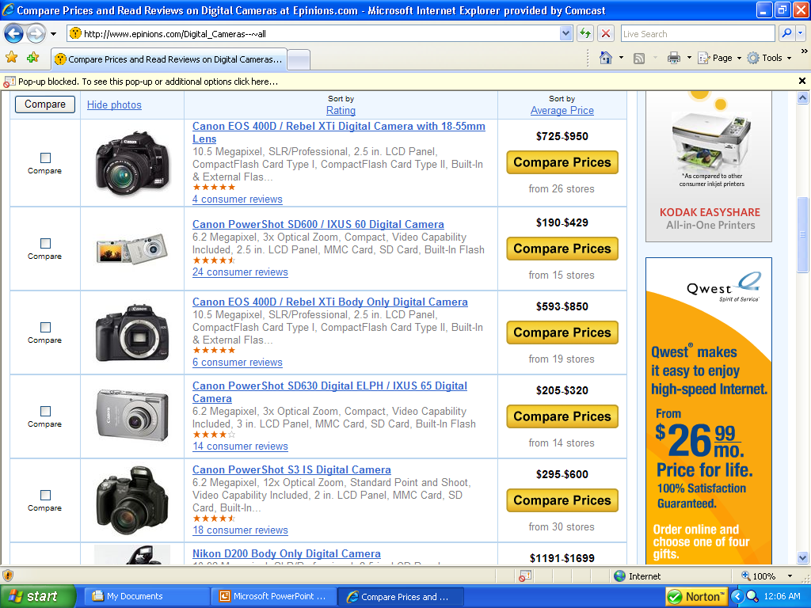
Support Vector Machine: Classification
Sentiment Categorization
Motivation: Market Research!!!
Gathering consumer preference data is expensive
Yet its also essential when introducing new products or improving existing ones.
Software for mining online review forums….$10,000
Information gathered…….priceless.
(www.epinions.com)

Slide 16
Support Vector Machine: Classification
Sentiment Classification Experiment
Objective to test effectiveness of features and techniques for capturing opinions.
Test bed of 2000 digital camera product reviews taken from www.epinions.com.
1000 positive (4-5 star) and 1000 negative (1-2 star) reviews
500 for each star level (i.e., 1,2,4,5)
Two experimental settings were tested
Classifying 1 star versus 5 star (extreme polarity)
Classifying 1+2 star versus 4+5 star (milder polarity)
Feature set encompassed a lexicon of 3000 positive or negatively oriented adjectives and word n-grams.
Compared C4.5 decision tree against SVM.
Both run using 10-fold cross validation.

Slide 17
Support Vector Machine: Classification
Sentiment Classification Experimental Results
SVM significantly outperformed C4.5 on both experimental settings.
The improved performance of SVM was attributable to its ability to better detect reviews containing sentiments with less polarity.
Many of the milder (2 and 4 star) reviews contained positive and negative comments about different aspects of the product.
It was more difficult for the C4.5 technique to detect the overall orientation of many of these reviews.
 | Techniques
Sentiments | SVM | C4.5
Extreme Polarity | 93.00 | 91.05
Mild Polarity | 89.40 | 85.20

Slide 18
ONTOLOGY

Slide 19
Ontology
Ontology represents knowledge as a set of concepts with a domain, using a shared vocabulary to denote types, properties, and interrelationships of those concepts.
Ontology is often used to extract named entities, detect entity relations and conduct sentiment analysis. Commonly used ontologies are listed below:
Name | Creator | Description | Application
WordNet | Princeton University | A large lexical database of English. | Word sense disambiguation
 |  |  | Text summarization
 |  |  | Text similarity analysis
SentiWordNet | Andrea Esuli, Fabrizio Sebastian | A lexical resource for opinion mining. | Sentiment analysis
Linguistic Inquiry and Word Count (LIWC) | James W. Pennebaker, Roger J. Booth, Martha E. Francis | LIWC is a lexical resource for sentiment analysis. | Sentiment analysis
 |  |  | Affect analysis
 |  |  | Deception detection
Unified Medical Language System (UMLS) | US National Library of Medicine | The Unified Medical Language System (UMLS) is a compendium of many controlled vocabularies in the biomedical sciences. | Medical entity recognition
MedEffect | Canadian Adverse Drug Reaction Monitoring Program(CADRMP) | A knowledge base about drug and side effect in Canada | Medical entity recognition
 |  |  | Drug safety surveillance
Consumer Health Vocabulary (CHV) | University of Utah | Mapping consumer health vocabulary to standard medical terms in UMLS. | Medical entity recognition, Health social media analytics
FDA’s Adverse Event Reporting System (FAERS) | United States Food and Drug Administration | Documenting adverse drug event reports and drug indications of all the medical products in US market. | Medical entity recognition

Slide 20
WordNet
WordNet is an online lexical database in which English nouns, verbs, adjectives and adverbs are organized into sets of synonyms.
Each word represents a lexicalized concept. Semantic relations link the synonym sets (synsets).
WordNet contains more than 118,000 different word forms and more than 90,000 senses.
Approximately 17% of the words in WordNet are polysemous (have more than on sense); 40% have one or more synonyms (share at lease one sense in common with other words).

Slide 21
WordNet
Six semantic relations are presented in WordNet because they apply broadly throughout English and because a user need not have advanced training in linguistics to understand them. The table below shows the included semantic relations.
WordNet has been used for a number of different purposes in information systems, including word sense disambiguation, information retrieval, text classification, text summarization, machine translation and semantic textual similarity analysis .
Semantic Relation | Syntactic Category | Examples
Synonymy (similar) | Noun, Verb, Adjective, Adverb | Pipe, tube Rise, ascent Sad, happy Rapidly, speedily
Antonymy (opposite) | Adjective, Adverb | Wet, dry Powerful, powerless Rapidly, slowly
Hyponymy (subordinate) | Noun | Maple, tree Tree, plant
Meronymy (part) | Noun | Brim, hat Ship, fleet
Troponomy (manner) | Verb | March, walk Whisper, speak
Entailment | Verb | Drive, ride Divorce, marry

Slide 22
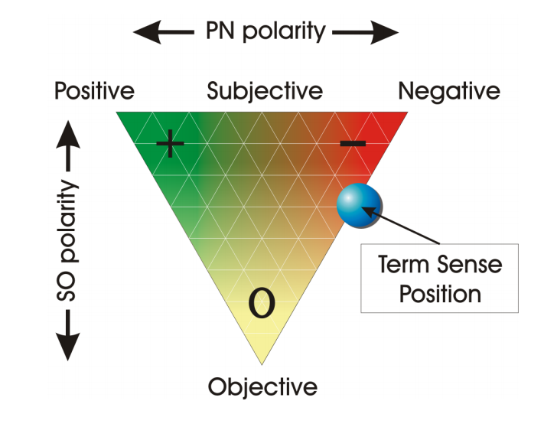
SentiWordNet
SentiWordNet is a lexical resource explicitly devised for supporting sentiment analysis and opinion mining applications.
SentiWordNet is the result of the automatic annotation of all the synsets of WordNet according to the notions of “positivity”, “negativity” and “objectivity”.
Each of the “positivity”, “negativity” and “objectivity” scores ranges in the interval [0.0,1.0], and their sum is 1.0 for each synset.
The figure above shows the graphical representation adopted by SentiWordNet for representing the opinion-related properties of a term sense.

Slide 23
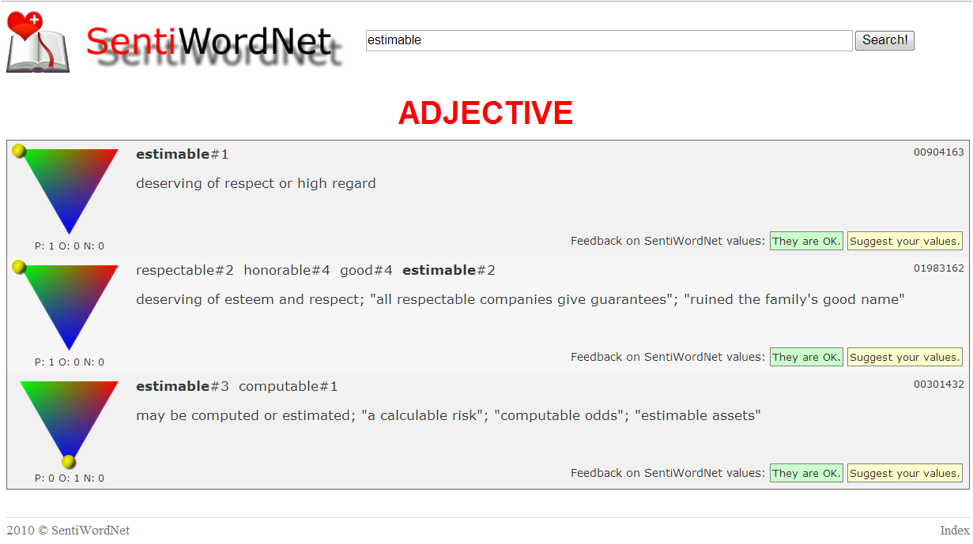
SentiWordNet
In SentiWordNet, different senses of the same term may have different opinion-related properties.
Search term
Sense 1
Positivity, objectivity and negativity score
Sense 2
Sense 3
Synonym of estimable in this sense
The figure above shows the visualization of opinion related properties of the term estimable in SentiWordNet (http://sentiwordnet.isti.cnr.it/search.php?q=estimable).

Slide 24
Linguistic Inquiry and Word Count (LIWC)
Linguistic Inquiry and Word Count (LIWC) is a text analysis program that looks for and counts word in psychology-relevant categories across text files.
Empirical results using LIWC demonstrate its ability to detect meaning in a wide variety of experimental settings, including to show attentional focus, emotionality, social relationships, thinking styles, and individual differences.
LIWC is often adopted in NLP applications for sentiment analysis, affect analysis, deception detection and etc..

Slide 25
Linguistic Inquiry and Word Count (LIWC)
The LIWC program has two major components: the processing component and the dictionaries.
Processing
Opens a series of text files (posts, blogs, essays, novels, and so on)
Each word in a given text is compared with the dictionary file.
Dictionaries: the collection of words that define a particular category
English dictionary: over 100,000 words across over 80 categories examined by human experts.
Major categories: functional words, social processes, affective processes, positive emotion, negative emotion, cognitive processes, biological processes, relativity and etc..
Multilingual: Arabic, Chinese, Dutch, French, German, Italian, Portuguese, Russian, Serbian, Spanish and Turkish.

Slide 26
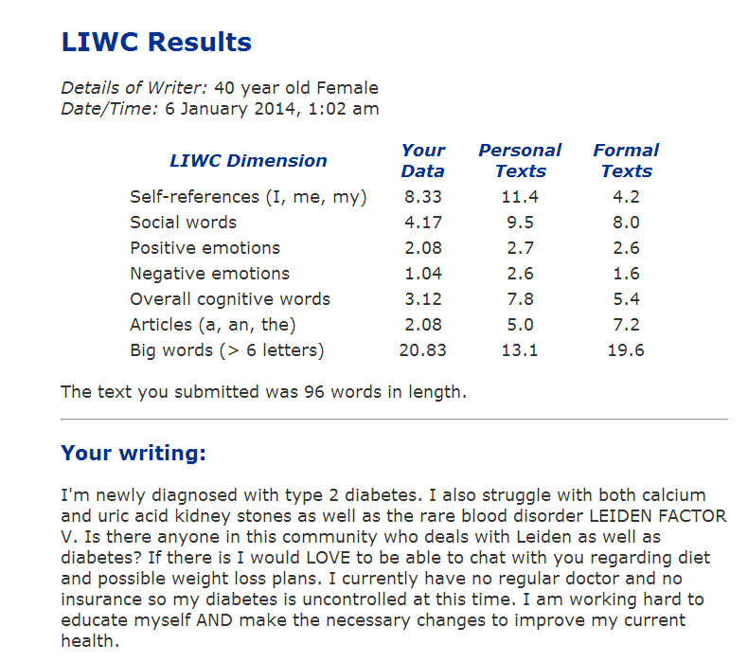
Linguistic Inquiry and Word Count (LIWC)
LIWC results from input text
LIWC results from personal text and formal writing for comparison
LIWC categories
Input text: A post from a 40 year old female member in American Diabetes Association online community
LIWC online demo: http://www.liwc.net/tryonlineresults.php

Slide 27
Unified Medical Language System (UMLS)
The Unified Medical Language System (UMLS) is a repository of biomedical vocabularies developed by the US National Library of Medicine.
UMLS integrates over 2.5 million names for 900,551 concepts from more than 60 families of biomedical vocabularies, as well as 12 million relations among these concepts.
Ontologies integrated in the UMLS Metathesaurus include the NCBI taxonomy, Gene Ontology (GO), the Medical Subject Headings (MeSH), Online Mendelian Inheritance in Man (OMIM), University of Washington Digital Anatomist symbolic knowledge base (UWDA) and Systematized Nomenclature of Medicine—Clinical Terms(SNOMED CT).

Slide 28
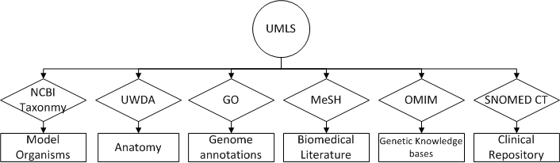
Unified Medical Language System (UMLS)
Major Ontologies integrated in UMLS
Name | Creator | Description | Application
National Center for Biotechnology Information (NCBI) Taxonomy | National Library of Medicine | All of the organisms in public sequence database | Identify organisms
University of Washington Digital Anatomist Source Information (UWDA) | University of Washington Structural Informatics Group | Symbolic models of the structures and relationships that constitute the human body. | Identify terms in anatomy
Gene Ontology (GO) | Gene Ontology Consortium | Gene product characteristics and gene product annotation data | Gene product annotation
Medical Subject Headings (MeSH) | National Library of Medicine | Vocabulary thesaurus used for indexing articles for PubMed | Cover terms in biomedical literature
Online Mendelian Inheritance in Man (OMIM) | McKusick-Nathans Institute of Genetic Medicine Johns Hopkins University | human genes and genetic phenotypes | Annotate human genes
Systematized Nomenclature of Medicine--Clinical Terms (SNOMED CT) | College of American Pathologists | Comprehensive, multilingual clinical healthcare terminology in the world | Identify clinical terms

Slide 29
Unified Medical Language System (UMLS)
Accessing UMLS data
No fee associated, license agreement required
Available for research purposes, restrictions apply for other kinds of applications
UMLS related tools
MetamorphoSys (command line program)
UMLS installation wizard and customization tool
Selecting concepts from a given sub-domain
Selecting the preferred name of concepts
MetaMap (Java)
Extracts UMLS concepts from text
Variable length of input text
Outputs a ranked listed of UMLS concepts associated with input text

Slide 30
Consumer Health Vocabulary (CHV)
Consumer Health Vocabulary (CHV) is a lexicon linking UMLS standard medical terms to health consumer vocabulary.
Laypeople have different vocabulary from healthcare professionals to describe medical problems.
CHV helps to bridge the communication gap between consumers and healthcare professionals by mapping the UMLS standard medical terms to consumer health language.
It has been applied in prior studies to better understand and match user expressions for medical entity extraction in social media (Yang et al. 2012; Benton et al. 2011).

Slide 31
Shared Tasks (Competitions) in Healthcare and NLP

Slide 32
Introduction
Shared task series in Nature Language Processing often represent a community-wide trend and hot topics which are not fully explored in the past.
Many competitions and shared tasks, e.g.,
Conference on Nature Language Learning (CoNLL) Shared Tasks
Joint Conference on Lexical and Computational Semantics (*SEM) Shared Tasks
BioNLP
i2b2 Challenge

Slide 33
BioNLP
Overview
BioNLP shared tasks are organized by the ACL’s (Association for Computational Linguistics) special Interest Group for biomedical natural language processing.
BioNLP 2013 was the twelfth workshop on biomedical natural language processing and held in conjunction with the annual ACL or NAACL meeting.
BioNLP shared tasks are bi-annual event held with the BioNLP workshop since 2009.

Slide 34
i2b2 Challenges
Informatics for Integrating Biology and the Bedside (i2b2) is an NIH funded National Center for Biomedical Computing (NCBC).
I2b2 center organizes data challenges to motivate the development of scalable computational frameworks to address the bottleneck limiting the translation of genomic findings and hypotheses in model systems relevant to human health.
I2b2 challenge workshops are held in conjunction with Annual Meeting of American Medical Informatics Association.

Slide 35
Previous i2b2 Challenges
Year | Task | Data | Release Date | End Date
2012 | Temporal relation extraction | EHR | Jun. 2012 | Sept. 2012
2011 | Co-reference resolution | EHR | Jun. 2011 | Sept. 2011
2010 | Relation extraction on medical problems | Discharge summaries | Apr. 2010 | Sept. 2010
2009 | Medication extraction | Narrative patient records | Jun. 2009 | Sept. 2009
2008 | Recognizing Obesity and co-morbidities | Discharge summaries | Mar. 2008 | Sept. 2008
2006 | De-identified discharge summaries | Discharge summaries | Jun. 2006 | Sept. 2006

Slide 36
TOPIC MODELING

Slide 37
Topic Modeling
Topic models are a suite of algorithms for discovering the main themes that pervade a large and otherwise unstructured collection of documents.
Topic Modeling algorithms include Latent Semantic Analysis (LSA), Probability Latent Semantic Indexing (PLSI), and Latent Dirichlet Allocation (LDA).
Among them, Latent Dirichlet Allocation (LDA) is the most commonly used nowadays.
Topic modeling algorithms can be applied to massive collections of documents.
Recent advances in this field allow us to analyze streaming collections, like you might find from a Web API.
Topic modeling algorithms can be adapted to many kinds of data.
They have been used to find patterns in genetic data, images, and social networks.

Slide 38
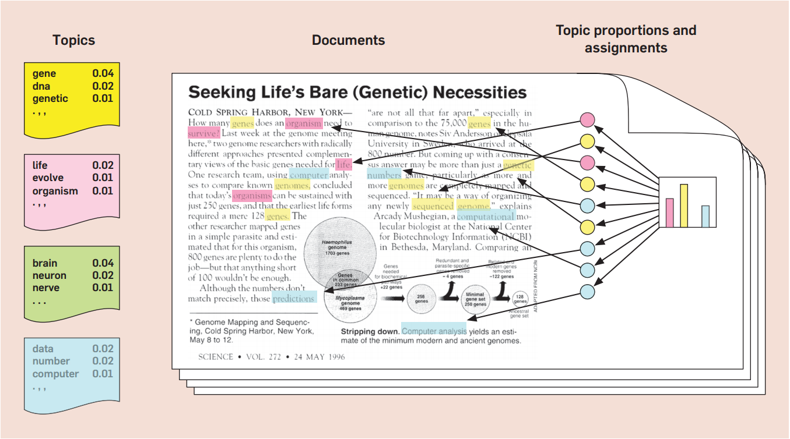
Topic Modeling - LDA
The figure below shows the intuitions behind latent Dirichlet allocation. We assume that some number of “topics”, which are distributions over words, exist for the whole collection (far left). Each document is assumed to be generated as follows. First choose a distribution over the topics (the histogram at right); then, for each word, choose a topic assignment (the colored coins) and choose the word from the corresponding topic .

Slide 39
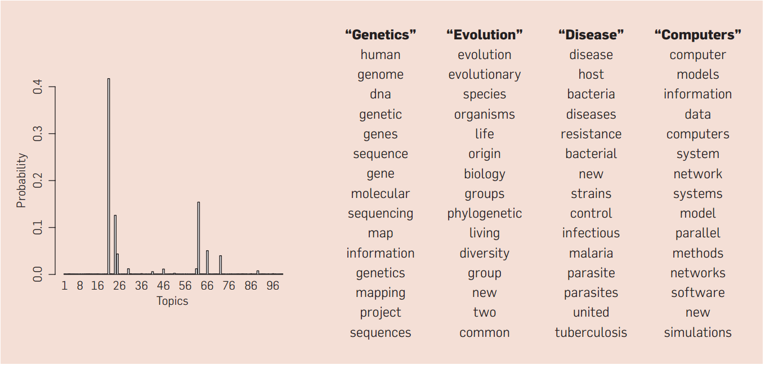
Topic Modeling - LDA
The figure below show real inference with LDA. 100-topic LDA model is fitted to 17,000 articles from journal Science. At left are the inferred topic proportions for the example article in previous figure. At right are the top 15 most frequent words from the most frequent topics found in this article.

Slide 40
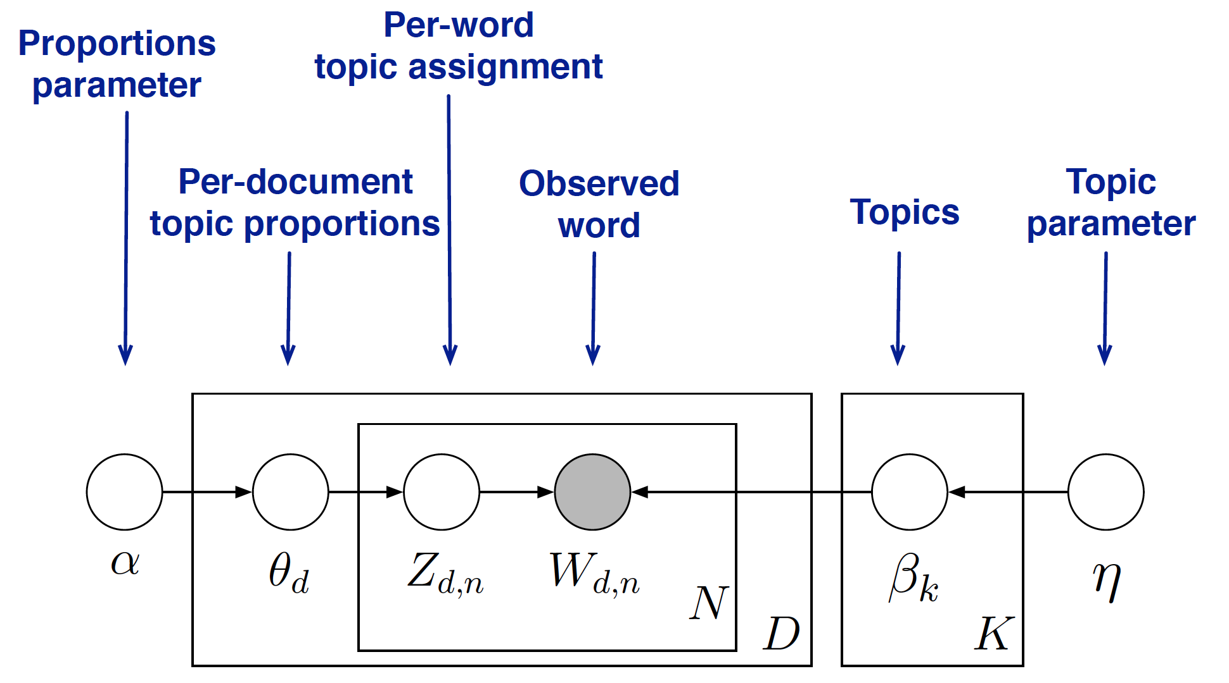
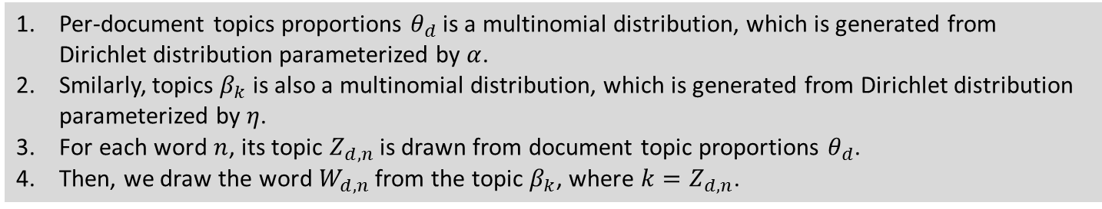
LDA: Probabilistic Graphical Model
Per-document topics proportions $θ_{d}$ is a multinomial distribution, which is generated from Dirichlet distribution parameterized by $α$.
Smilarly, topics $β_{k}$ is also a multinomial distribution, which is generated from Dirichlet distribution parameterized by $η$.
For each word $n$, its topic $Z_{d,n}$ is drawn from document topic proportions $θ_{d}$.
Then, we draw the word $W_{d,n}$ from the topic $β_{k}$, where $k=Z_{d,n}$.

Slide 41
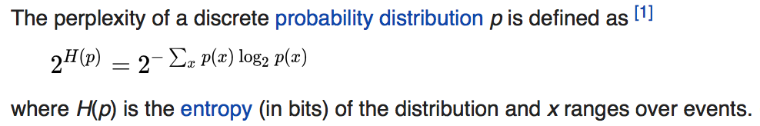
Model Selection: Perplexity
The author of LDA suggests to select the number of topics from 50 to 150 (Blei 2012); however, the optimal number usually depends on the size of the dataset.
Cross validation on perplexity (a measure of entropy) is often used for selecting the number of topics.
The following plot illustrates the selection of optimal number of topics for 4 datasets, i.e., minimum perplexity.

Slide 42
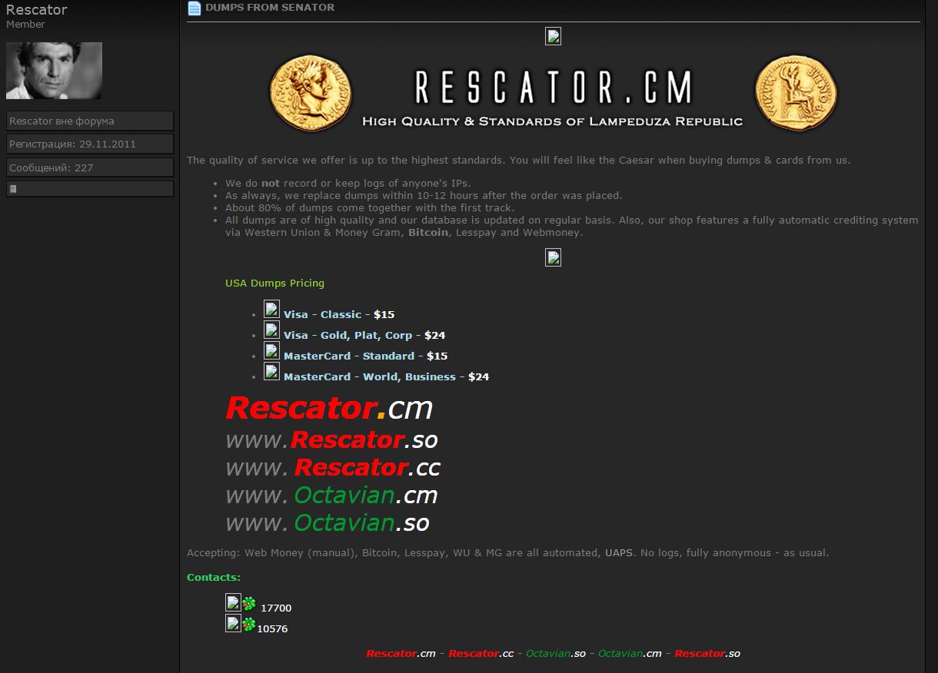
Cybersecurity Research Example – Profiling Underground Economy Sellers
To profile the seller, we seek to identify the major topics in its advertisement.
Description of the stolen data/service
Seller of stolen data: Rescator
Prices of the stolen data
Contact: a dedicated shop and ICQ
Payment Options
42

Slide 43
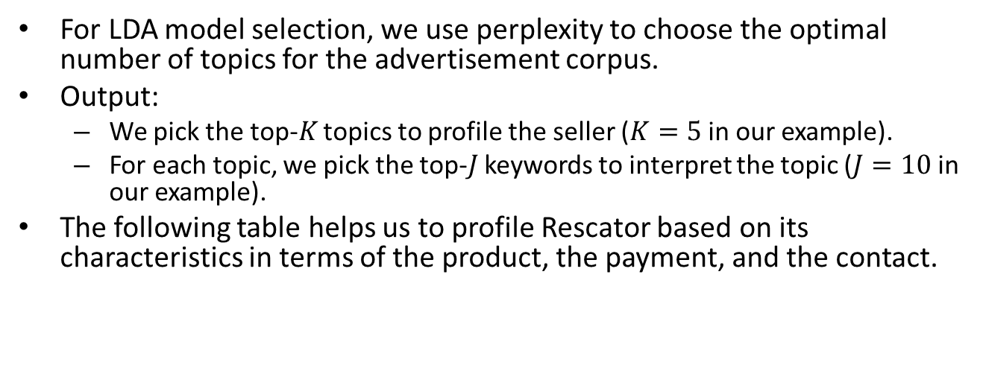
Cybersecurity Research Example – Profiling Underground Economy Sellers
For LDA model selection, we use perplexity to choose the optimal number of topics for the advertisement corpus.
Output:
We pick the top-$K$ topics to profile the seller ($K=5$ in our example).
For each topic, we pick the top-$J$ keywords to interpret the topic ($J=10$ in our example).
The following table helps us to profile Rescator based on its characteristics in terms of the product, the payment, and the contact.
Top Seller Characteristics of Rescator
# | Top Keywords | Interpretation
5 | shop, wmz, icq, webmoney, price, dump, | Product: CCs, dumps (valid, verified); Payment: wmz, webmoney, bitcoin, lesspay; Contact: shop, register, deposit, email, icq, jabber
6 | валид(valid), чекер(checker), карты(cards), баланс(balance), карт(cards)
8 | shop, good, CCs, bases, update, cards, bitcoin, webmoney, validity, lesspay
11 | dollars, dumps, deposit, payment, sell, online, verified
16 | email, shop, register, icq, account, jabber,

Slide 44
Topic Modeling - Tools
Name | Model/Algorithm | Language | Author | Notes
lda-c | Latent Dirichlet allocation | C | D. Blei | This implements variational inference for LDA.
class-slda | Supervised topic models for classification | C++ | C. Wang | Implements supervised topic models with a categorical response.
lda | R package for Gibbs sampling in many models | R | J. Chang | Implements many models and is fast . Supports LDA, RTMs (for networked documents), MMSB (for network data), and sLDA (with a continuous response).
tmve | Topic Model Visualization Engine | Python | A. Chaney | A package for creating corpus browsers.
dtm | Dynamic topic models and the influence model | C++ | S. Gerrish | This implements topics that change over time and a model of how individual documents predict that change.
ctm-c | Correlated topic models | C | D. Blei | This implements variational inference for the CTM.
Mallet | LDA, Hierarchical LDA | Java | A. McCallum | Implements LDA and Hierarchical LDA
Stanford topic modeling toolbox | LDA, Labeled LDA, Partially Labeled LDA | Java | Stanford NLP Group | Implements LDA, Labeled LDA, and PLDA

Slide 45
Word Embedding

Slide 46
Word Embedding
Word embedding is one of the most popular language models recently.
Representation of document vocabulary
It is capable of capturing context of a word in a document, semantic and syntactic similarity, relation with other words, etc.
Loosely speaking, word embeddings are vector representations of particular words.

Slide 47
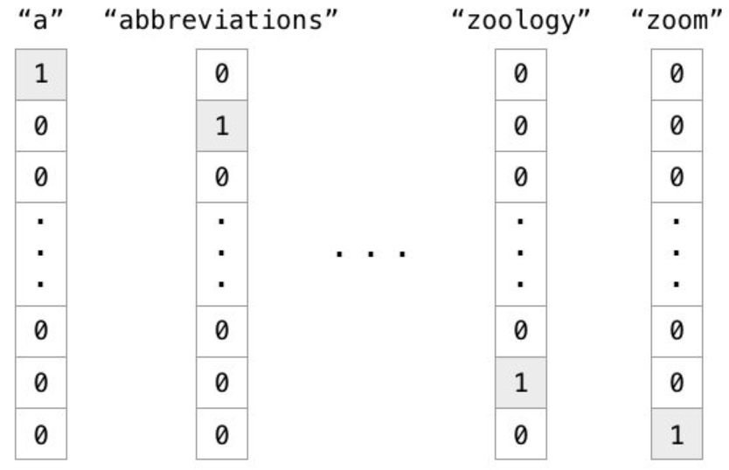
Why Do We Need It?
In the traditional Vector Space Model (VSM), each word is represented in a separate dimension.
The dimensionality of VSM equals the vocabulary size.
Each word is independent.

Slide 48
Why Do We Need It?
However, this simple representation does not capture the relationships between words.
E.g., “Berlin” <-> “Germany”, “Beijing” <-> “China”
The high dimensionality often leads to very sparse representations.
Word2Vec, one of the most popular technique to learn word embeddings, aims to learn a more compact (low-dimensionality) representation of words, with their relationships preserved.

Slide 49
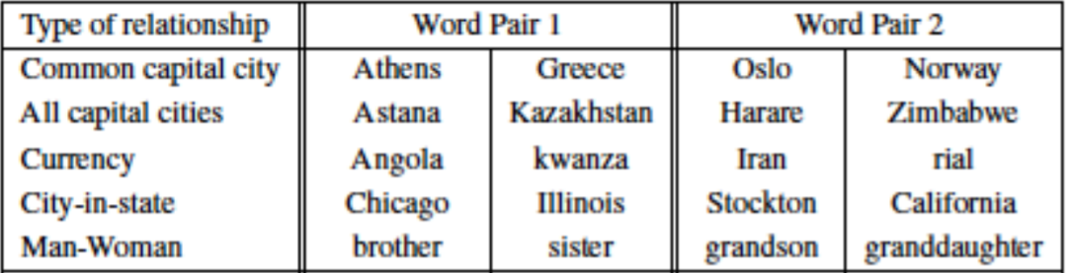
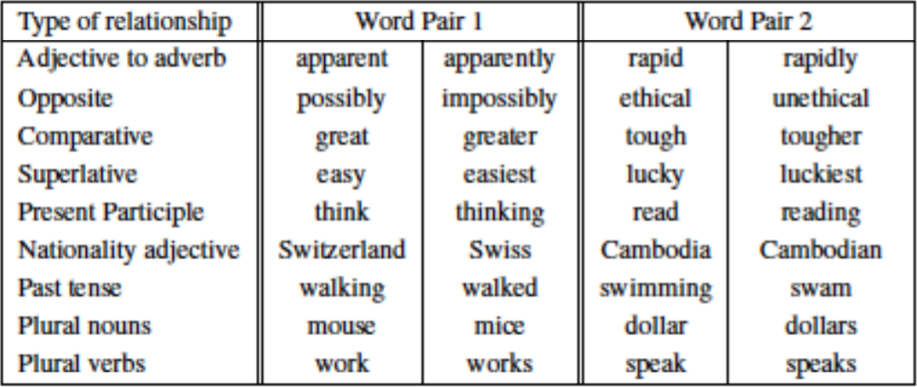
Word Relationships
Semantic
Syntactic

Slide 50
Vector Representation of Words
Vector space models (VSMs) represent (embed) words in a continuous vector space
Theoretical foundation in Linguistics: Distributional Hypothesis
Words with similar meanings will occur with similar neighbors if enough text material is available (Rubenstein et al. 1967).
Approaches that leverage VSMs can be divided into two categories
Approach | Example | Description
Count-based methods | Latent semantic analysis | Compute how often some word co-occurs with its neighbor words in a large text corpus, and then map these count-statistics down to a small, dense vector for each word
Predictive methods | Neural probabilistic language model | Directly predict a word from its neighbors in terms of learned small, dense embedding vectors (considered parameters of the model)

Slide 51
Word2vec –Vector Representation of Words (Mikolov et al. 2013)
Word2vec: computationally-efficient, 2-layer predictive NN for learning word embeddings from raw text
Considered deep for its ability to digest expansive data sets quickly
Can be used for unsupervised learning of words
Relationships between different words
Ability to abstract higher meaning between words (e.g., Tucson is a city in the state of Arizona)
Useful for language modeling, sentiment analysis, and more
Tucson
Arizona
City
State
Car
Truck
Hand
Glove
Tucson
Arizona

Slide 52
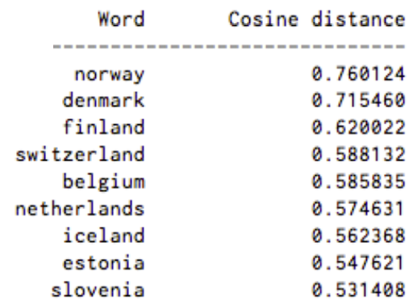
Word2vec –Vector Representation of Words (Mikolov et al. 2013)
Its input is a text corpus and its output is a set of vectors or “embeddings” (feature vectors for words in that corpus)
Similarity between two embeddings represents conceptual similarity of words
Example results: words associated with Sweden, in order of proximity:

Slide 53
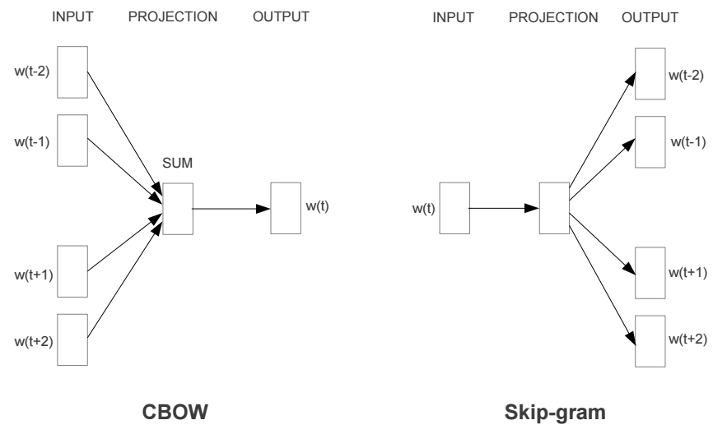
Word2vec –Vector Representation of Words (Mikolov et al. 2013)
Word2vec comes with two models:
Model | Approach | Speed and Performance | Use case
Continuous Bag-of-Words model (CBOW) | The CBOW predicts the current word based on the context. | Faster to train than the skip-gram model | Predicts frequent words better
Skip-Gram model | Skip-gram predicts surrounding words given the current word. | Usually performs better than CBOW | Predicts rare words better
Notes:
Algorithmically, these models are similar, except that CBOW predicts target words (e.g. 'mat') from source context words ('the cat sits on the'), while the skip-gram does the inverse and. This inversion might seem like an arbitrary choice, but statistically it has the effect that CBOW smoothes over a lot of the distributional information (by treating an entire context as one observation). For the most part, this turns out to be a useful thing for smaller datasets. However, skip-gram treats each context-target pair as a new observation, and this tends to do better when we have larger datasets. We will focus on the skip-gram model in the rest of this tutorial.

Slide 54
Word2vec –Vector Representation of Words (Mikolov et al. 2013)
Skip-gram learning:
Given w_{0,} predict w₋₂, w₋₁, w₁, and w₂
Conversely, CBOW tries to predict w₀ when given w₋₂, w₋₁, w₁, and w₂
w₋₂ | w₋₁ | w₀ | w₁ | w₂
? | ? | Network | ? | ?
w₋₂ | w₋₁ | w₀ | w₁ | w₂
Recurrent | Neural |  | Language | Model
Notes:
Algorithmically, these models are similar, except that CBOW predicts target words (e.g. 'mat') from source context words ('the cat sits on the'), while the skip-gram does the inverse and. This inversion might seem like an arbitrary choice, but statistically it has the effect that CBOW smoothes over a lot of the distributional information (by treating an entire context as one observation). For the most part, this turns out to be a useful thing for smaller datasets. However, skip-gram treats each context-target pair as a new observation, and this tends to do better when we have larger datasets. We will focus on the skip-gram model in the rest of this tutorial.

Slide 55
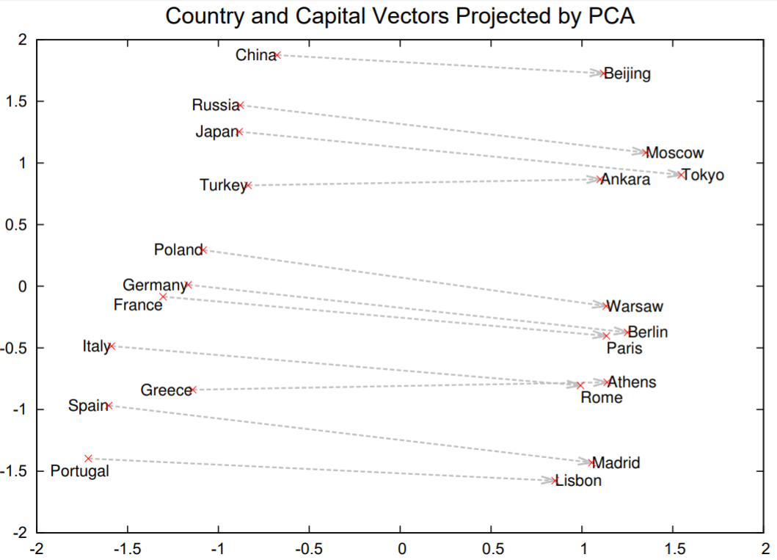
Word2Vec Visualization
Embeddings of sample word pairs trained with 1000-dimensional Skip-gram

Slide 56
Word2Vec Example: Hacker Terms
The output of Word2Vec is a file called Vectors.bin
Can be opened and viewed in plaintext
Contains embeddings of each word in corpus
Generated embeddings can be used in two ways:
Directly evaluated to better understand underlying corpus
Fed into other models and deep learning algorithms as features
Hacker Forum Sentences
Word2Vec
Word Embeddings
Lexical Semantics
Learning Task and Training Algorithm
Word Embeddings

Slide 57
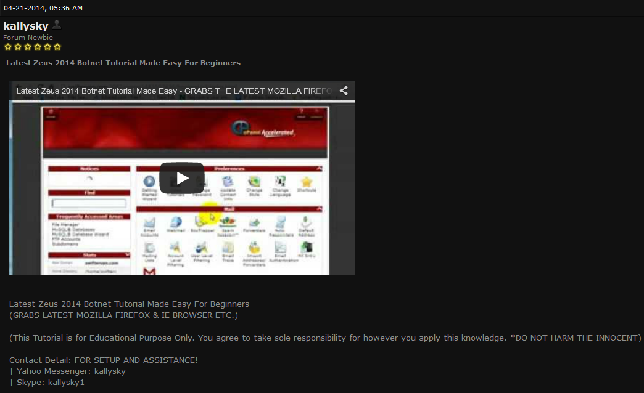
Word2Vec Example
Example: Zeus refers to a botnet and not Greek mythology
Word2Vec can provide automated understanding of unfamiliar terms and language
We further explore this use-case as an illustrative example
Video tutorial for configuring Zeus botnet
Message text: “Latest Zeus 2014 Botnet Tutorial Made Easy For Beginners”

Slide 58
Word2Vec Example
We directly evaluate word embeddings in this study
Embeddings are vectors, can use cosine similarity to find similar words
Useful in hacker context to discover new hacker terms, tool names, etc.
Evaluation
Benchmark Experiments
 | Most Similar Embeddings for “Botnet”
 | Word | Similarity Score
1 | Citadel | 0.561456
2 | Zeus | 0.554653
3 | Partners | 0.548900
4 | Pandemiya | 0.545221
5 | Mailer | 0.540075
6 | Panel | 0.524557
7 | Linksys | 0.498224
8 | Cythosia | 0.480465
9 | Phase | 0.464738
10 | Spyeye | 0.459695
P@10 | 70%
Hacker Term Similarity

Slide 59
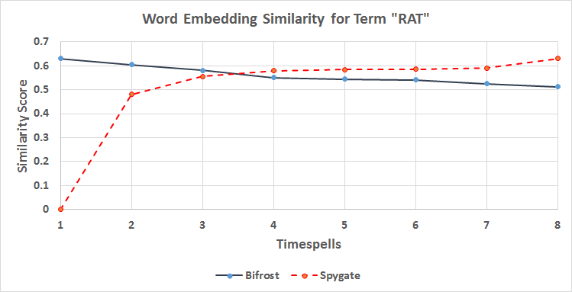
Word2Vec Example
Bifrost and Spygate are remote administration tools (RATs) that grant hackers backdoor access to victim computers
Can look at their similarity with word RAT over time to assess evolving significance in discussions concerning RATS
Evaluation
Benchmark Experiments
Hacker Term Similarity

Slide 60
Running Word2Vec
Download: https://code.google.com/archive/p/word2vec/
Word2Vec comes bundled with many files. Two important ones:
Word2vec.c - the actual Word2Vec program written in C; is executed in command line
Demo-word.sh - shell script containing example of how to run Word2Vec.c on test data
To use Word2Vec, you need:
A corpus (e.g., collection of tweets, news articles, product reviews)
Word2Vec expects a sequence of sentences as input
One input file containing many sentences, with one sentence per line
A C programming language compiler
Unix environments are easiest - Linux generally ships with ‘gcc’ pre-installed, OSX can use Xcode
Word2Vec is useful for language modeling tasks,

Slide 61
Implementation
Self-trained embeddings
Keras has a specific layer, Embedding, that can turn positive integers (indexes) into dense vectors of fixed size. (https://keras.io/layers/embeddings)
Google pre-trained embeddings
Link; Tutorial
1.5GB; 3 million words and phrases
Trained on ~100 billion words from a Google News dataset
Vector dimensionality: 300

Slide 62
Deep Learning Resources
Name | Language | Link | Note
Pylearn2 | Python | http://deeplearning.net/software/pylearn2/ | A machine learning library built on Theano
Theano | Python | http://deeplearning.net/software/theano/ | A python deep learning library
Caffe | C++ | http://caffe.berkeleyvision.org/ | A deep learning framework by Berkeley
Torch | Lua | http://torch.ch/ | An open source machine learning framework
Overfeat | Lua | http://cilvr.nyu.edu/doku.php?id=code:start | A convolutional network image processor
Deeplearning4j | Java | http://deeplearning4j.org/ | A commercial grade deep learning library
Word2vec | C | https://code.google.com/p/word2vec/ | Word embedding framework
GloVe | C | http://nlp.stanford.edu/projects/glove/ | Word embedding framework
Doc2vec | C | https://radimrehurek.com/gensim/models/doc2vec.html | Language model for paragraphs and documents
StanfordNLP | Java | http://nlp.stanford.edu/ | A deep learning-based NLP package
TensorFlow | Python | http://www.tensorflow.org | A deep learning based python library

Slide 63
A-Z list of Open Source NLP toolkits

Slide 64
Name | Main Features | Language | Creators | Website
Antelope framework | Part-of-speech tagging, dependency parsing, WordNet lexicon | C#, VB.net | Proxem | [1]
Apertium | Machine translation for language pairs from Spanish, English, French, Portuguese, Catalan and Occitan | C++, Java | (various) | [2]
ClearTK | Wrappers for machine learning libraries (SVMlight, LibSVM, OpenNLP MaxEnt) and NLP tools (Snowball Stemmer, OpenNLP, Stanford CoreNLP) | Java | The Center for Computational Language and Education Research at the University of Colorado Boulder | [3]
cTakes | Sentence boundary detection, tokenization, normalization, POS tagging, chunking, context (family history, symptoms, disease, disorders, procedures) annotator, negation detection, dependency parsing, drug mention annotator | Java | Children's Hospital Boston, Mayo Clinic | [4]
DELPH-IN | Deep linguistic analysis: head-driven phrase structure grammar (HPSG) and minimal recursion semantic parsing | LISP, C++ | Deep Linguistic Processing with HPSG Initiative | [5]
Factorie | scalable NLP toolkit for named entity recognition, relation extraction, parsing, pattern matching, and topic modeling(LDA) | Java | University of Massachusetts Amherst | [6]
FreeLing | Tokenization, sentence splitting, contradiction splitting, morphological analysis, named entity recognition, POS tagging, dependency parsing, co -reference resolution | C++ | Universitat Politècnica de Catalunya | [7]
General Architecture for Text Engineering (GATE) | Information extraction (tokenization, sentence splitter, POS tagger, named entity recognition, coreference resolution), machine learning library wrapper (Weka, MaxEnt, SVMLight, RASP, LibSVM), Ontology (WordNet) | Java | GATE open source community | [8]
Graph Expression | Information extraction (named entity recognition, relation and fact extraction, parsing and search problem solving) | Java | Startup huti.ru | [9]

Slide 65
Name | Main Features | Language | Creators | Website
Learning Based Java | POS tagger, Chunking, coreference resolution, named entity recognition | Java | Cognitive Computation Group at UIUC | [10]
LingPipe | Topic classification, named entity recognition, clustering, POS tagging, spelling correction, sentiment analysis, logistic regression, word sense disambiguation | Java | Alias-i | [11]
Mahout | Scalable machine learning libraries (logistic regression, Naïve Bayes, Random Forest, HMM, SVM, Neural Network, Boosting, K-means, Fuzzy K-means, LDA, Expectation Maximization, PCA ) | Java | Online community | [12]
Mallet | Document classification(Naïve Bayes, Maximum Entropy, decision trees), sequence tagging (HMM, MEMM, CRF), topic modeling (LDA, Hierarchical LDA) | Java | University of Massachusetts Amherst | [13]
MetaMap | Map biomedical text to the UMLS Metathesaurus and discover Metathesaurus concepts referred to in text. | Java | National Library of Medicine | [14]
MII nlp toolkit | de-identification tools for free-text medical reports | Java | UCLA Medical Imaging Informatics (MII) Group | [15]
MontyLingua | Tokenization, POS tagging, chunking, extractors for phrases and subject/verb/object tuples from sentences, morphological analysis, text summarization | Python, Java | MIT | [16]
Natural Language Toolkit (NLTK) | Interface to over 50 open access corpora, lexicon resource such as WordNet, text processing libraries for classification, tokenization, stemming, POS tagging, parsing and semantic reasoning. | Python | Online community | [17]
NooJ (based onINTEX) | Morphological analysis, syntactic parsing, named entity recogntion | .NET Framework-based | University of Franche-Comté, France | [18]

Slide 66
Name | Main Features | Language | Creators | Website
OpenNLP | Tokenization, sentence segmentation, POS tagging, named entity extraction, chunking, parsing, coreference resolution | Java | Online community | [19]
Pattern | Wrapper for Google, Twitter and Wikipedia API, web crawler, HTML DOM parsing, POS tagging, n-gram search, sentiment analysis, WordNet, machine learning algorithms for clustering and classification, network analysis and visualization | Python | Tom De Smedt, CLiPS,University of Antwerp | [20]
PSI-Toolkit | Text preprocessing, sentence splitting, tokenization, lexical and morphological analysis, syntactic/ semantic parsing, machine translation | C++ | Adam Mickiewicz University in Poznań | [21]
ScalaNLP | Tokenization, POS tagging, sentence segmentation, sequence tagging (CRF, HMM), machine learning algorithms (linear regression, Naïve Bayes, SVM, K-Means, LDA, Neural Network ) | Scala | David Hall and Daniel Ramage | [22]
Stanford NLP | Tokenization, POS tagging, named entity recognition, parsing, coreference, topic modeling, classification (Naïve Bayes, logistic regression, maximum entropy), sequence tagging(CRF) | Java | The Stanford Natural Language Processing Group | [23]
Rasp | Tokenization, POS tagging, lemmatization, parsing | C++ | University of Cambridge, University of Sussex | [24]
Natural | Tokenization, stemming, classification (Naïve Bayes, logistic regression),morphological analysis, WordNet | JavaScript, NodeJs | Chris Umbel | [25]
Text Engineering Software Laboratory (Tesla) | Tokenization, POS tagging, sequence alignment | Java | University of Cologne | [26]
Treex | Machine translation | Perl | Charles University in Prague | [27]

Slide 67
Name | Main Features | Language | Creators | Website
UIMA | Industry standard for content analytics, contains a set of rule based and machine learning annotators and tools | Java / C++ | Apache | [28]
VisualText | Tokenization, POS tagging, named entity recognition, classification, text summarization | NLP++ / compiles to C++ | Text Analysis International, Inc | [29]
WebLab-project | Language identification, named entity recognition, semantic analysis, relation extraction, text classification and clustering, text summarization | Java / C++ | OW2 | [30]
UniteX | Tokenization, sentence boundary detection, parsing, morphological analysis, rule-based named entity recognition, text alignment, word sense disambiguation | Java & C++ | Laboratoire d'Automatique Documentaire et Linguistique | [31]
The Dragon Toolkit | tools for accessing PubMed, TREC collection, NewsGroup articles, Reuters Articles, and Google Search Engine, ontologies (UMLS, WordNet, MeSH), tokenization, stemming, POS tagging, named entity recognition, classification (Naïve Bayes, SVM-light, LibSVM, logistic regression), clustering (K-Means, hierarchical clustering), topic modeling(LDA), text summarization, | Java | Drexel University | [32]
Text Extraction, Annotation and Retrieval Toolkit | Tokenization, chunking, sentence segmenting, parsing, ontology(WordNet), topic modeling (LDA), named entity recognition, stemming, machine learning algorithms (decision tree, SVM, neural network) | Ruby | Louis Mullie | [33]
Zhihuita NLP API | Chinese text segmentation, spelling checking, pattern matching, | C | Zhihuita.org | [34]

Slide 68
References
I2b2:https://www.i2b2.org/
Benton A., Ungar L., Hill S., Hennessy S., Mao J., Chung A., & Holmes J. H. (2011). Identifying potential adverse effects using the web: A new approach to medical hypothesis generation. Journal of biomedical informatics, 44(6), pp. 989-996.
Bian, J., Topaloglu, U., & Yu, F. (2012). Towards large-scale twitter mining for drug-related adverse events. In Proceedings of the 2012 ACM International Workshop on Smart health and wellbeing, pp. 25-32.
Bunescu R.C., Mooney R.J. (2005). A Shortest Path Dependency Kernel for Relation Extraction. In: Proceedings of the conference on Human Language Technology and Empirical Methods in Natural Language Processing, pp. 724-731.
Chee B. W., Berlin R., & Schatz B. (2011). Predicting adverse drug events from personal health messages. In: AMIA Annual Symposium Proceedings Vol. 2011, pp. 217-226
Culotta, A., & Sorensen, J. (2004, July). Dependency tree kernels for relation extraction. In Proceedings of the 42nd Annual Meeting on Association for Computational Linguistics Association for Computational Linguistics, pp. 423-429.
Leaman R., Wojtulewicz L, Sullivan R, Skariah A., Yang J, Gonzalez G. (2010) Towards Internet- Age Pharmacovigilance: Extracting Adverse Drug Reactions from User Posts to Health-Related Social Networks, In: Proceedings of the 2010 Workshop on Biomedical Natural Language Processing, ACL, pp.117-125.
Liu, X., & Chen, H. (2013). AZDrugMiner: an information extraction system for mining patient-reported adverse drug events in online patient forums. In Smart Health. Springer Berlin Heidelberg, pp. 134-150.
Yang C. C., Yang H., Jiang L., & Zhang M. (2012). Social media mining for drug safety signal detection. In: Proceedings of the 2012 international workshop on Smart health and wellbeing ACM, pp. 33-40.
Zelenko D., Aone C. and Richardella A(2003): Kernel methods for relation extraction. Journal of Machine Learning Research, 3, pp.1083-1106.

Slide 69
References
Mikolov, T., Chen, K., Corrado, G., & Dean, J. (2013). Efficient estimation of word representations in vector space. arXiv preprint arXiv:1301.3781; ICLR Workshop.
Mikolov, T., Sutskever, I., Chen, K., Corrado, G. S., & Dean, J. (2013). Distributed representations of words and phrases and their compositionality. In Advances in Neural Information Processing Systems (pp. 3111-3119).

